Slide 1
Dynamic Design

Slide 2

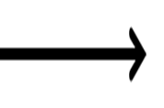
For ECU 1:
1-Draw a state machine diagram for each ECU component
a)
b)
Door state message
10 msec
ECU2 receive message
Light switch state message
20 msec
ECU2 receive message

Slide 3
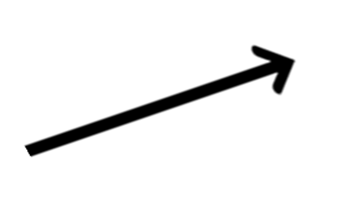


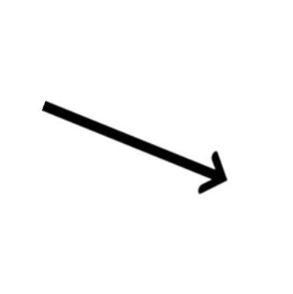

For ECU 1:
Speed state message
5 msec
ECU2 receive message
c)
2-Draw a state machine diagram for the ECU operation
Door state message
10 msec
Idle
Light switch state message
20 msec
ECU2 receive message
5 msec
Speed state message

Slide 4
For ECU 1:
3-Draw the sequence diagram for the ECU
APP
Door sensor
Light switch
Speed sensor
DIO
ADC
CAN
Loop
DoorSensor_Read()
DIO_Read( PortNum, PinNum)
CAN_SendByte(Data)
LightSwitch_Read()
DIO_Read( PortNum, PinNum)
CAN_SendByte(Data)
SpeedSensor_Read()
ADC_ReadChannel(Channel_Num)
CAN_SendByte(Data)

Slide 5
For ECU 2:
a)Draw a state machine diagram for each ECU component
door is opened while the car is moving
Buzzer ON and Lights OFF
Check Door state message and speed state message
door is opened while the car is stopped
Buzzer OFF and Lights ON
door is closed while the lights were ON
Check again
Lights OFF after 3 seconds

Slide 6
For ECU 2:
car is stopped and the light switch is pressed
Buzzer ON and Lights ON
Check Light switch state message and speed state message
car is moving and the light switch is pressed
Buzzer OFF and Lights ON
Check again

Slide 7
For ECU 2:
2-Draw a state machine diagram for the ECU operation
door is opened while the car is moving
Buzzer ON and Lights OFF
Check Door state message and speed state message
door is closed while the lights were ON
Lights OFF after 3 seconds
Idle
door is opened while the car is stopped
car is moving and the light switch is pressed
Buzzer OFF and Lights ON
Check Light switch state message and speed state message
car is stopped and the light switch is pressed
Buzzer ON and Lights ON

Slide 8
For ECU 2:
APP
Right light
Left light
Buzzer
CAN
DIO
Loop
CAN_ReceiveByte(void)
[ if door is opened while the car is moving ]
Buzzer(ON)
DIO_Write(u8 PortNum,u8 PinNum,ON)
Right_Light(OFF)
DIO_Write(u8 PortNum,u8 PinNum,OFF)
Left_Light(OFF)
DIO_Write(u8 PortNum,u8 PinNum,OFF)
[ if door is opened while the car is stopped ]
Buzzer(OFF)
DIO_Write(u8 PortNum,u8 PinNum,OFF)
Right_Light(ON)
DIO_Write(u8 PortNum,u8 PinNum,ON)
Left_Light(ON)
DIO_Write(u8 PortNum,u8 PinNum,ON)
[ if door is closed while the lights were ON]
Left_Light(OFF)
OFF after 3 seconds
Right_Light(OFF)
OFF after 3 seconds

Slide 9
For ECU 2:
Continue:
APP
Right light
Left light
Buzzer
CAN
DIO
Loop
CAN_ReceiveByte(void)
[ if car is moving and light switch is pressed]
Buzzer(OFF)
DIO_Write(u8 PortNum,u8 PinNum,OFF)
Right_Light(ON)
DIO_Write(u8 PortNum,u8 PinNum,ON)
Left_Light(ON)
DIO_Write(u8 PortNum,u8 PinNum,ON)
[ if car is moving and the light switch is pressed]
Buzzer(ON)
DIO_Write(u8 PortNum,u8 PinNum,ON)
Right_Light(ON)
DIO_Write(u8 PortNum,u8 PinNum,ON)
Left_Light(ON)
DIO_Write(u8 PortNum,u8 PinNum,ON)

